Slide 1

Proposal: Support for Implementation of AI Tooling August 2025

Slide 2
AI Tooling Implementation Executive Summary
This proposal provides details on two different engagements. One engagement, shown at left below, is expected to start in September. The other engagement focused on enabling effective measurements – shown at right – is available for TBI Bank if desired and can be started whenever convenient.
AI Tooling On-Demand Advisory Support
Measurement Enablement Project
Flexible, time-based access to expert advisory and support with weekly meetings to facilitate progress
General support for all initiatives related to AI tooling in R&D and particularly focused on GitHub Copilot
Emphasis on tool roll-out and change management activities to foster deep adoption and usage
Discussions on troubleshooting key problems and other “hot spot” areas where results are below expectations
Support for upcoming initiatives and planning further evolutions of AI strategy
Utilizing data to understand real behavior and performance changes, then setting goals to expand
Review of current dashboarding and reporting methodologies
Identification of targets and enablement of goal setting for key GitHub Copilot metrics
Analysis of trends relative to typical industry norms, including Unique Active Users, Weekly Active Users, Changes in LOC / Story Points / Tickets / etc.
Identification of top users and non-users of AI tooling

Slide 3
AI Tooling On-Demand Advisory Support

Slide 4
AI Tooling On-Demand Advisory Support Engagement Approach
Expected topics include:
Change Management & Measurement – Launching a structured adoption program, including an AI champions network, tailored communications, and robust usage metrics to track real behavioral change.
Communications Program – Rolling out a sequenced awareness and engagement plan, from executive announcements to live demos, hands-on workshops, and weekly success stories, ensuring deep and sustained messaging.
Champions Program – Selecting high-social-capital individuals to evangelize AI usage, support peers, collect feedback, and amplify successes, with incentives tied to influence, skills, and visibility.
The goal is to build an AI-first culture that’s embedded in daily work, supported by trusted advocates, and monitored through clear and real performance indicators.
Logistics
Working Group:
Oleksandr Kyslashko
Georgi Georgiev
Executive Sponsor:
Gurkan Papila, SVP Tech
Expected meetings:
Weekly 1 hour working group discussions covering a range of topics as needed and as requested by TBI
Additional meetings and support are available if needed upon request
Engagement cost:
Hours are billed at €300 per hour, invoiced monthly based on consumption
Expected monthly cost:
€1,000 - €1,500

Slide 5
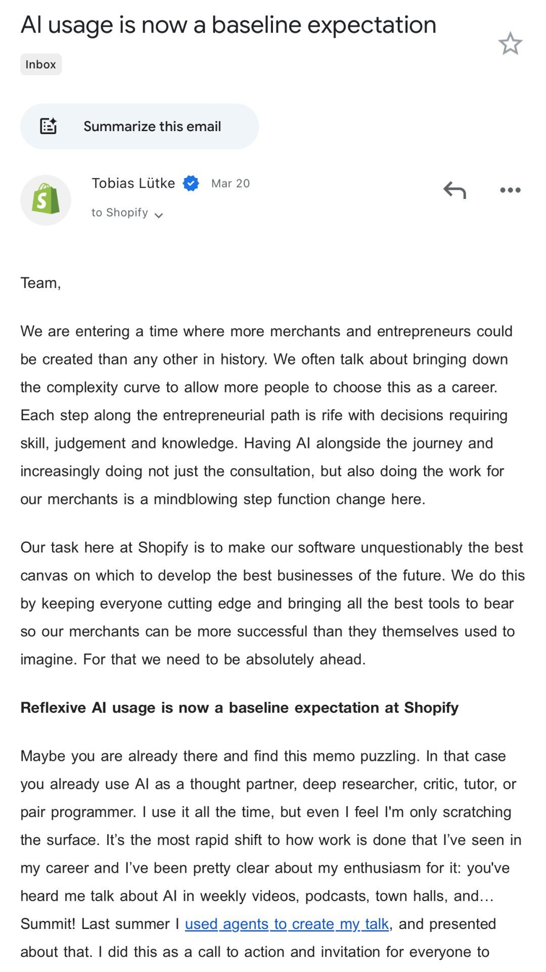
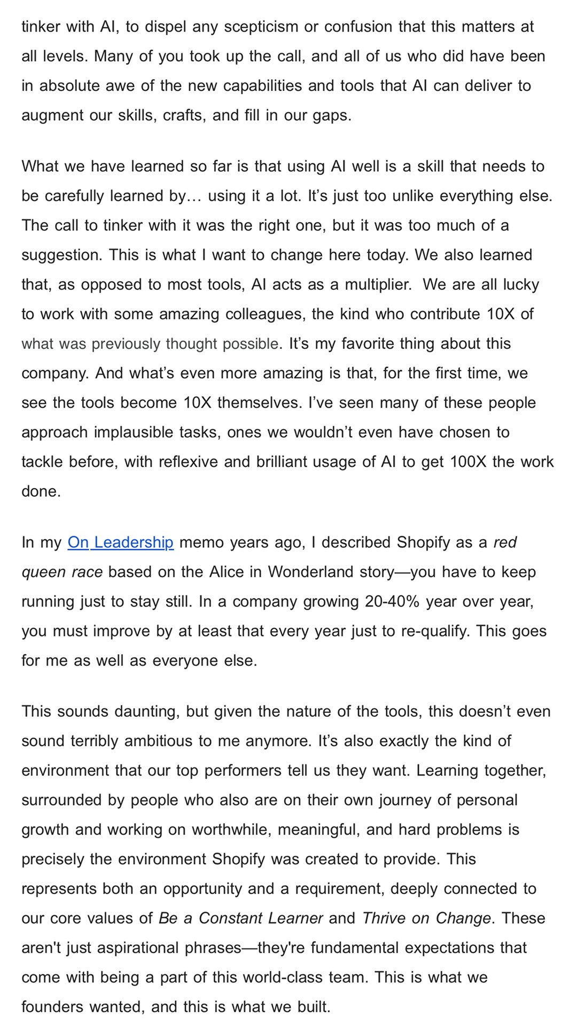

Change Examples Industry Charters
Page 1 of 2
Key Attributes:
Length: charter is highly detailed and explanatory, potentially exceeding the attention span of most readers flipping through emails
Audience: Tobias Lütke (CEO) appeals to both the business needs and the individual employee
Emotion: utilizes language that resonates beyond logic and connects with readers
Clarity: unambiguous path forward and company-wide endorsement of AI as the future
Next Steps: key events, activities, and changes that show what is being done to address AI

Slide 6
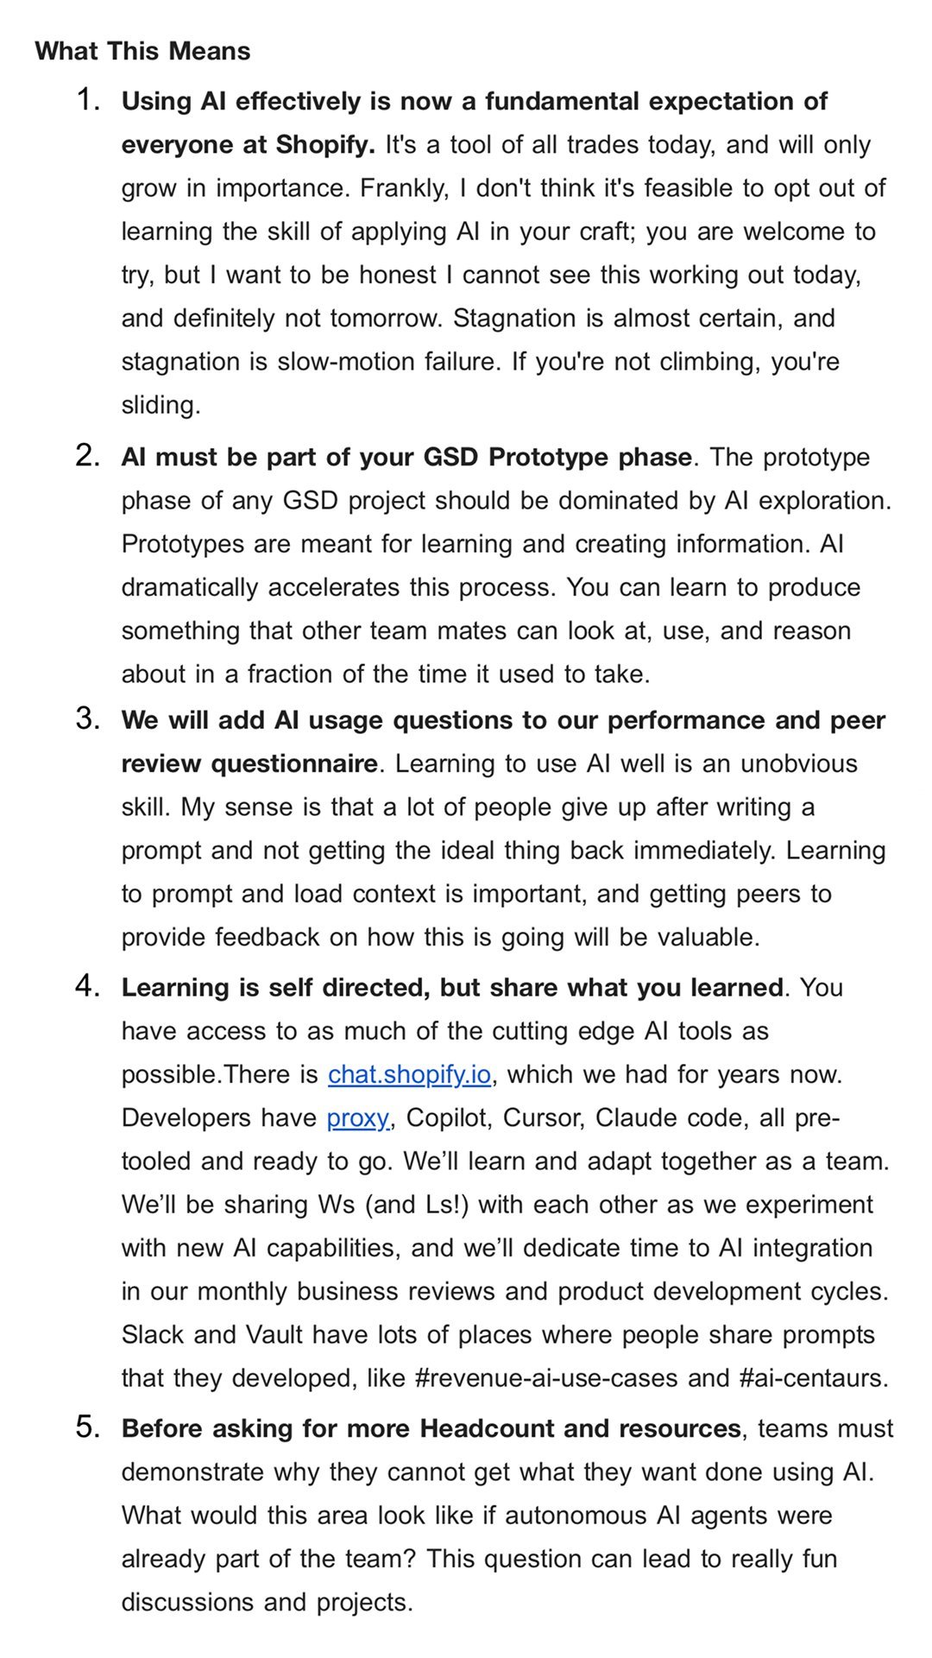
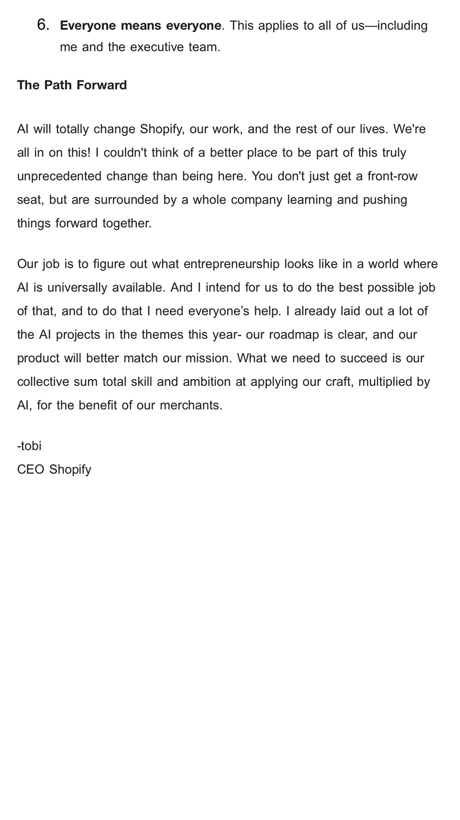
Change Examples Industry Charters
Page 2 of 2
Key Attributes:
Length: charter is highly detailed and explanatory, potentially exceeding the attention span of most readers flipping through emails
Audience: Tobias Lütke (CEO) appeals to both the business needs and the individual employee
Emotion: utilizes language that resonates beyond logic and connects with readers
Clarity: unambiguous path forward and company-wide endorsement of AI as the future
Next Steps: key events, activities, and changes that show what is being done to address AI

Slide 7
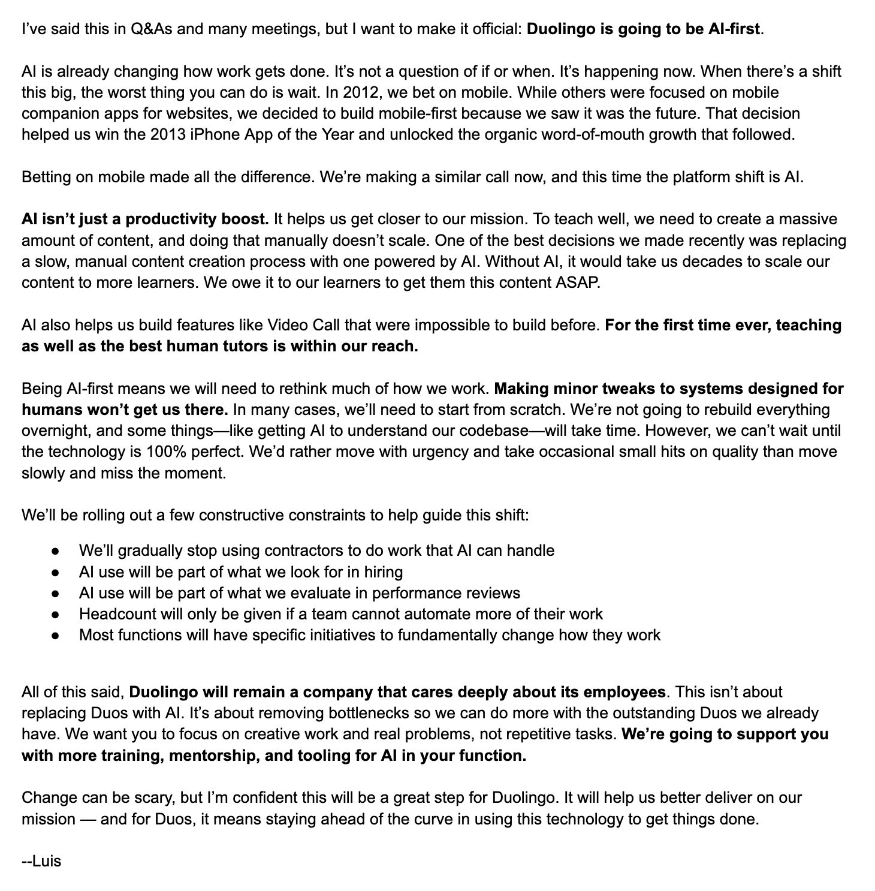

Change Examples Industry Charters
Page 1 of 1
Key Attributes:
Length: charter is short and direct with quick, short sentences and frequent paragraph breaks
Audience: Luis von Ahn (CEO) appeals mostly to business needs, mentioning employees only at the end of the charter
Emotion: utilizes intense and urgent language
Clarity: unambiguous aspiration, but fewer concrete details about how changes will occur
Next Steps: the “constructive constraints” are directionally helpful, but likely create more questions than answers for most readers

Slide 8
AI Tooling On-Demand Advisory Support Communications Planning Enables Repeated and Deep Messaging
PHASE 1: AWARENESS (Weeks 1-2)
Executive Announcement Email
Sender: CAIO / CEO
Timing: Week 1, Monday @ 9am
Content: High-level vision, business rationale, timeline overview
Tone: Forward-thinking, reference charter
Confluence Knowledge Hub
Launch: Week 1, Monday @ 12pm (following email)
Sections:
Why We're Embracing AI Tools
How These Tools Transform Our Work
Implementation Timeline
FAQ (continuously updated)
Success Stories (added during rollout)
Training Resources
Owner: Engineering Operations Team
Slack Channel Creation
Channel: #ai-coding-evolution
Purpose: Announcements, tips, wins sharing, community Q&A
Pinned Items: Links to Confluence, events, champion contacts
Initial Post: "The future of AI is here! Join us in the next chapter."
PHASE 2: EXPLORATION (Weeks 3-4)
Live Demo Town Hall
Format: Zoom, 45 minutes + 15 min Q&A
Presenters: AI Champions
Content: Live demonstration showing before/after GitHub Copilot use-cases and examples with high impact
Highlight: "This would’ve taken 3 hours; now only 15 minutes."
Team-by-Team Hands-On Workshops
Format: Small Zoom sessions (max 12 people)
Structure: 20 min guided tour, 40 min interactive practice
Materials: Prepared exercises with AI-assisted solutions
"AI Challenge" Contest
Format: 48-hour hackathon-style challenge
Task: Solve a complex problem using AI assistance
Prize: Recognition + premium desk setup accessories
Goal: Generate excitement and normalize tool usage
Weekly "AI Win" Email Series
Frequency: Every Monday morning
Content: One major success story per week
Format: Brief story + metrics + quote from consultant

Slide 9





AI Tooling On-Demand Advisory Support Champions Program Leverages High-Social-Capital Individuals
A champions program can help to elevate the AI-first culture to new heights, as long as the right individuals are included. These individuals should be popular and trusted by their peers, not just the most technically advanced AI users.
Expectations of Champions
Incentives for Champions
While being a champion is an “opt-in” group, there are still expectations of each participant:
Evangelize: Promote GitHub Copilot in meetings, chats, standups; share tips and 'aha' moments with peers.
Support: Host or attend weekly office hours; help teammates unblock issues and answer questions.
Feedback: Collect and relay success stories & pain points; contribute prompts and examples to our library of use-cases and successes.
Exclusive Access Be first to trial new tools & capabilities on the leading edge
Skill Development Level up GenAI fluency by teaching others and mentoring
Peer Impact Influence how teams work and learn together
Professional Growth Show leadership, build credibility, gain visibility org-wide
Make Work Better Reduce grunt work and focus on the most strategic areas

Slide 10
Measurement Enablement Project

Slide 11
Measurement Enablement Project Engagement Approach
This project is a fixed-fee effort focused on enabling a comprehensive framework to measure GitHub Copilot’s adoption, usage, and impact—from engineering productivity to downstream business outcomes:
Current State Assessment – Review existing dashboards, analytics tools, and reporting processes; identify gaps in AI tooling measurement.
Target Definition & Goal Enablement – Set clear KPIs for adoption, usage, engineering performance, and business impact, aligned with organizational OKRs.
Usage & Adoption Analytics – Integrate Copilot telemetry, track adoption and usage patterns, perform cohort analysis, and benchmark against industry norms. Support dashboarding construction.
Engineering Metrics Impact – Measure effects on delivery speed, code quality, defect rates, and maintainability compared to pre-Copilot baselines.
Downstream Business Impact – Quantify how productivity gains accelerate roadmap execution, enhance customer value, and improve cost efficiency.
Insights & Reporting Framework – Support dashboard evolution, establish governance and review cadences, and create feedback loops for continuous improvement.
Logistics
Working Group:
Oleksandr Kyslashko
Georgi Georgiev
Executive Sponsor:
Gurkan Papila, SVP Tech
Expected meetings:
Weekly 1 hour working group meetings progressing against a planned and detailed project plan
Ad hoc meetings will additionally be scheduled with key stakeholders, data teams, and visualization engineers
Engagement cost:
Full scope delivery is €18,000
Final scope to be confirmed prior to project kick-off to ensure alignment.

Slide 12
Measurement Enablement Project Detailed Scope (1 of 3)
1. Current State Assessment
Dashboard & Reporting Review
Inventory existing engineering productivity dashboards, GitHub Insights reports, and any AI tooling metrics currently tracked.
Assess data freshness, granularity, and accessibility for both technical and business stakeholders.
Evaluate current analytics tools (e.g., Power BI, Looker, Tableau) for capability to ingest and visualize Copilot data.
Gap Analysis
Identify missing data points related to Copilot adoption, usage, and performance impact.
Benchmark current metrics maturity against industry best practices in AI developer tooling measurement.
2. Target Definition & Goal Enablement
Metric Target Setting
Define KPIs for adoption (e.g., % of engineers using Copilot weekly), usage (e.g., code completion acceptance rate), engineering impact (e.g., reduced time-to-complete PRs), and business impact (e.g., faster feature delivery to customers).
Set both leading indicators (early usage patterns) and lagging indicators (productivity & business results).
Goal Alignment
Collaborate with Engineering, Product, and Business leaders to align targets with broader organizational OKRs.
Establish a baseline from pre-Copilot metrics to measure relative improvement.

Slide 13
Measurement Enablement Project Detailed Scope (2 of 3)
3. Usage & Adoption Analytics
Data Capture & Integration
Integrate GitHub Copilot telemetry into centralized analytics infrastructure. Track metrics such as:
Adoption: Active users, team adoption, user behavior.
Usage: Code suggestions viewed, accepted, edited, or rejected; usage frequency; session duration.
Feature Breadth: Language/framework diversity in Copilot-assisted code.
Cohort Analysis
Identify high-adoption vs. low-adoption teams.
Pinpoint “champion” engineers and non-users for targeted enablement.
Trend Analysis
Compare internal usage trends to industry norms and peer organizations.
4. Engineering Metrics Impact
Productivity Measures
Assess PR cycle times, commit frequency, code review turnaround times before and after Copilot adoption.
Measure impact on defect rates, rework frequency, and technical debt accumulation.
Quality & Maintainability
Analyze maintainability scores and complexity metrics for Copilot-assisted code.
Evaluate post-release defect rates for AI-assisted vs. manually written code.

Slide 14
Measurement Enablement Project Detailed Scope (3 of 3)
5. Downstream Business Impact
Delivery Acceleration
Link engineering productivity gains to faster roadmap execution and release frequency.
Customer Impact
Map release acceleration to tangible customer value (e.g., faster time-to-market for high-priority features).
Cost Efficiency
Quantify FTE effort saved and redeployed to higher-value initiatives.
6. Insights & Reporting Framework
Dashboard Design
Support creation of executive, manager, and engineer-facing dashboards tailored to decision-making needs.
Cadence & Governance
Establish a recurring measurement cadence (e.g., monthly performance reviews, quarterly impact assessments).
Define data governance rules to ensure privacy, compliance, and consistent metric definitions.
Continuous Improvement
Implement feedback loops to refine metrics, targets, and data sources as Copilot adoption matures.

Slide 15







Measurement Enablement Project Techniques For Measuring Adoption: Three Different Approaches
1
Survey assessment of developer population
Useful for rapid implementation of measurement since there is low overhead to perform surveys
Effective for productivity or capacity change, but also non-technical measures like satisfaction
Developers perceive surveys as an opportunity to have their voice “heard” by leadership
2
Analysis of Jira data to identify changes in story point volume over time or other changes
Calculation based on historical data pre- and post-implementation of GenAI tooling
Requires moderate to high data fidelity such that most developer activity has story points
However, these measures should differentiate between “productivity” and “capacity” change
3
3rd party tooling such as Milestone.ai or Jellyfish to deeply analyze usage of AI tooling
Immediate insights and deeper views of data by teams, products, and use cases
Includes broader Engineering insights such as coding time and productivity unrelated to AI
Cost can be significant factor, typically $30,000-$50,000 for midsize Engineering organization

Slide 16
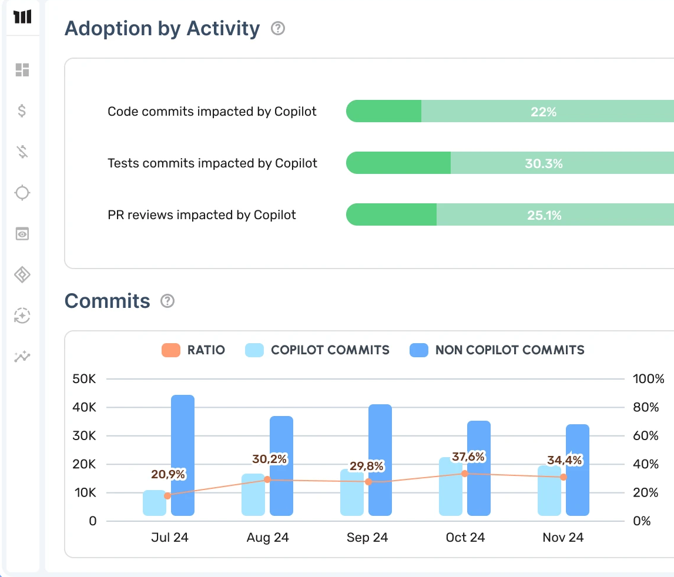
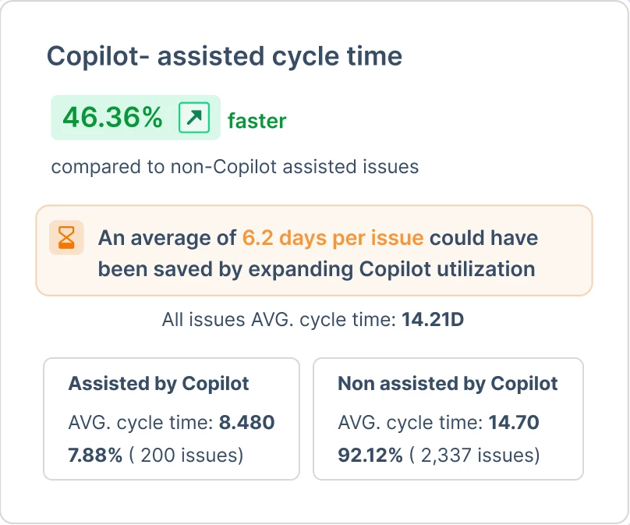
Measurement Enablement Project Milestone.ai: Using LLMs To Improve Measurement Accuracy
Milestone uses AI to associate Jira tickets with recently written code, enabling more precise and more detailed attribution of AI’s impact on development activities. Critically, Milestone is able to support multi-company views for PE sponsors to see cross-portfolio comparisons.

Slide 17
Measurement Enablement Project Techniques For Measuring Adoption: Productivity vs Capacity
Story Points Completed Q-1
Story Point Capacity Change
=
X
Time Spent Writing Code
Story Points Completed Q-2
Productivity Change
Specific to the task or activity
Capacity Change
Generalized across all tasks and activities

Slide 18
Appendix

Slide 19
AI Tooling Implementation Engagement Models
On-Demand Hourly-Based
Fixed-Fee Deployment
Flexible, time-based access to expert advisory and support, billed hourly as needed.
Ideal for ad hoc guidance, reviews, or team support during specific phases.
No minimum commitment; billed monthly in arrears.
Can scale up/down depending on internal team needs.
Best for organizations with internal capabilities and capacity but need expert perspective.
End-to-end deployment and enablement, delivered under a fixed scope and timeline.
Structured implementation plan, typically 10-12 weeks.
Scope can be customized but typically includes stakeholder alignment, approach definition, enablement sessions, rollout, and metrics analysis.
Defined deliverables, timelines, and outcomes.
Best for companies seeking rapid, low-risk rollout with clear accountability.

Slide 20
Thank You Please contact with questions: Henry Yelin henry@yelin.io FR: +33 07 82 61 05 44 US: +01 847 254 3508

